Slide 1
Statistical AI Agent for Dataset Analysis
A Parallel-Validation Statistical Analysis System
with AI-Powered Chat Interface
Lei GAO (s327756) • Lan DENG (s338219)

Slide 2
System Architecture Overview
Data Input
→
Preprocessing
→
Parallel Analysis
Statistical Tests
Automated ML
↓
Shared Session State
↓
Model Training
AI Agent Chat

Slide 3
Core Design Principles
Shared Analysis Cache
Parallel Feature Ranking
Eliminate duplicate computation by storing analysis results
Statistical and ML methods run independently for unbiased comparison
Branching Consumption
Session State Management
One analysis, multiple uses: Training + Chat both consume shared results
Cross-page data sharing enables flexible workflows

Slide 4
Data Processing Pipeline
CSV Upload
→
Data Validation
→
Preprocessing
Preprocessing Steps
Key Parameters
Missing Values: mean/median/mode/drop
• Missing Strategy
Encoding: Label Encoding / One-Hot Encoding
• Encoding Method
Scaling: StandardScaler / MinMaxScaler
• Scaling Technique
Label Creation: OK/KO Classification

Slide 5
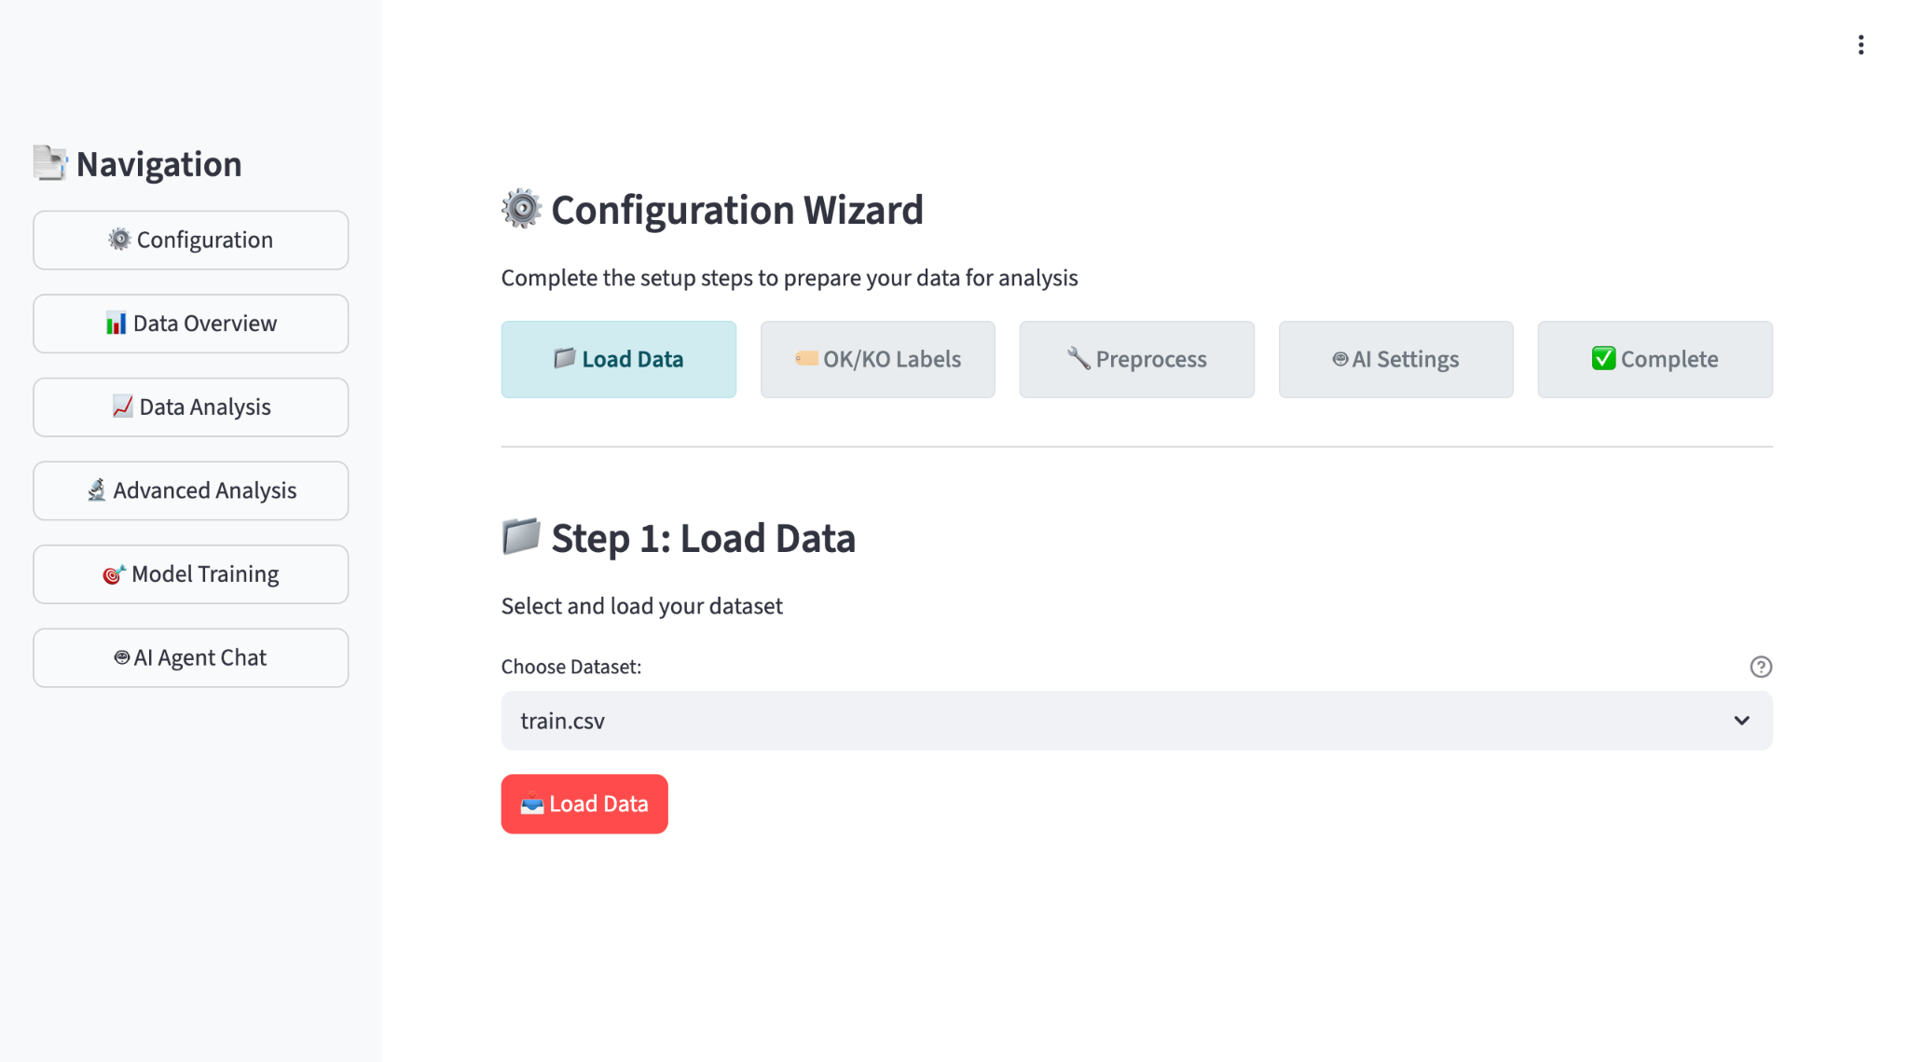
Configuration Interface

Slide 6
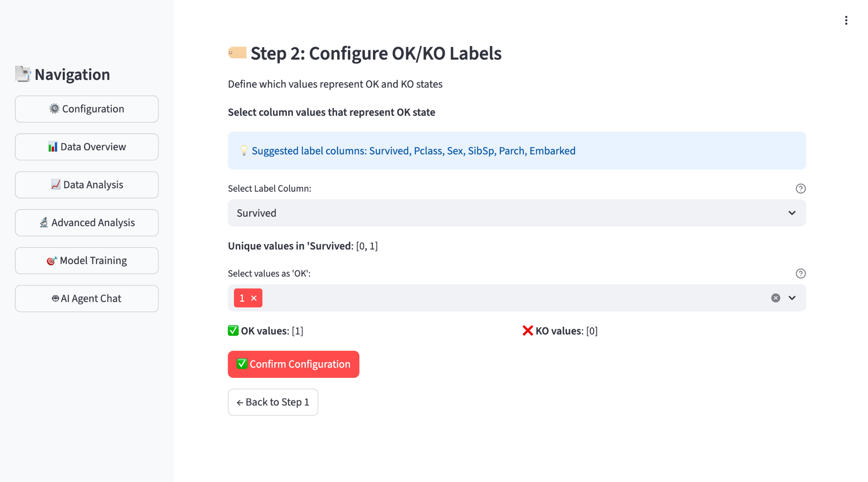
Configuration Interface
Users control all preprocessing parameters through intuitive web interface

Slide 7
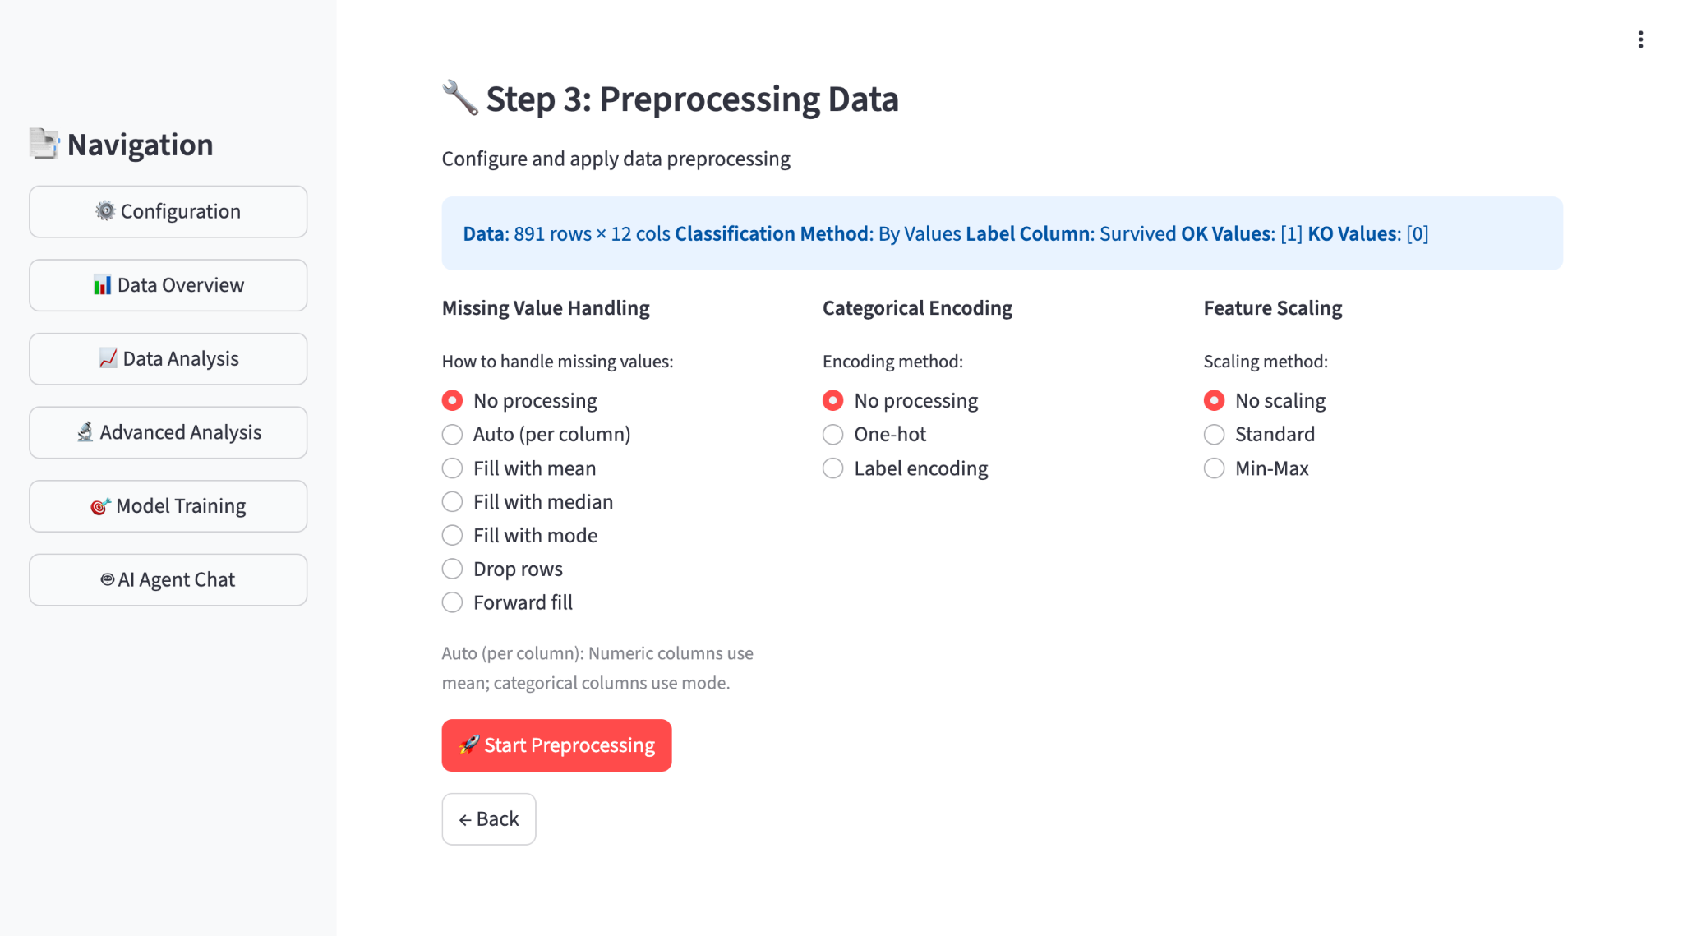
Configuration Interface
Users control all preprocessing parameters through intuitive web interface

Slide 8
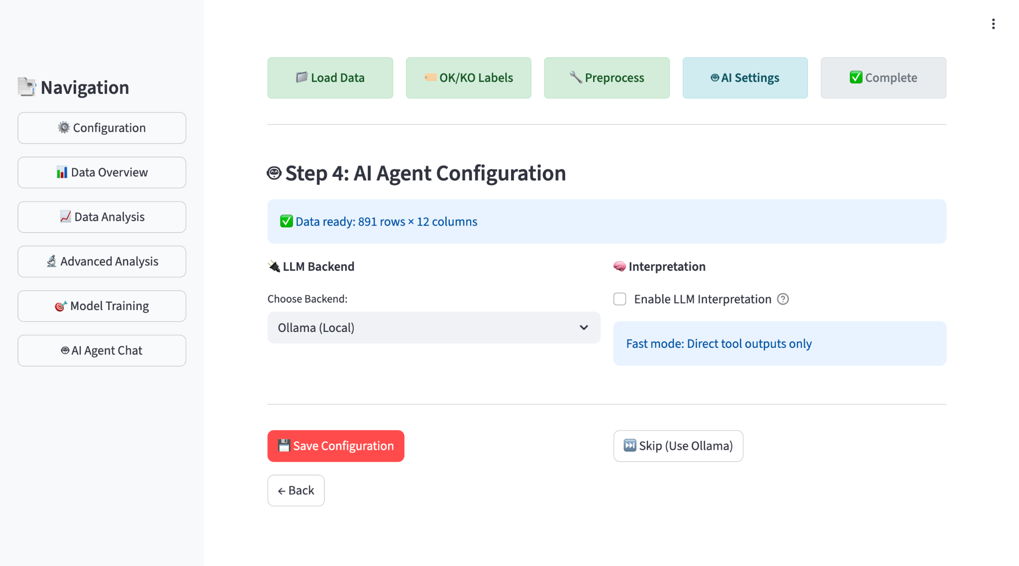
Configuration Interface
Users control all preprocessing parameters through intuitive web interface

Slide 9
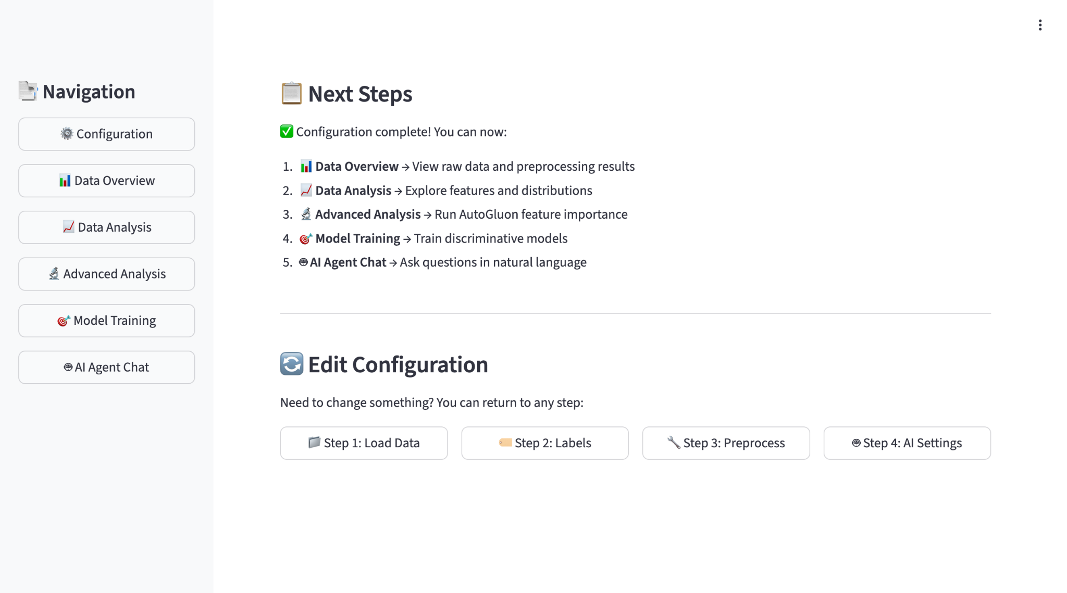
Configuration Interface
Users control all preprocessing parameters through intuitive web interface

Slide 10
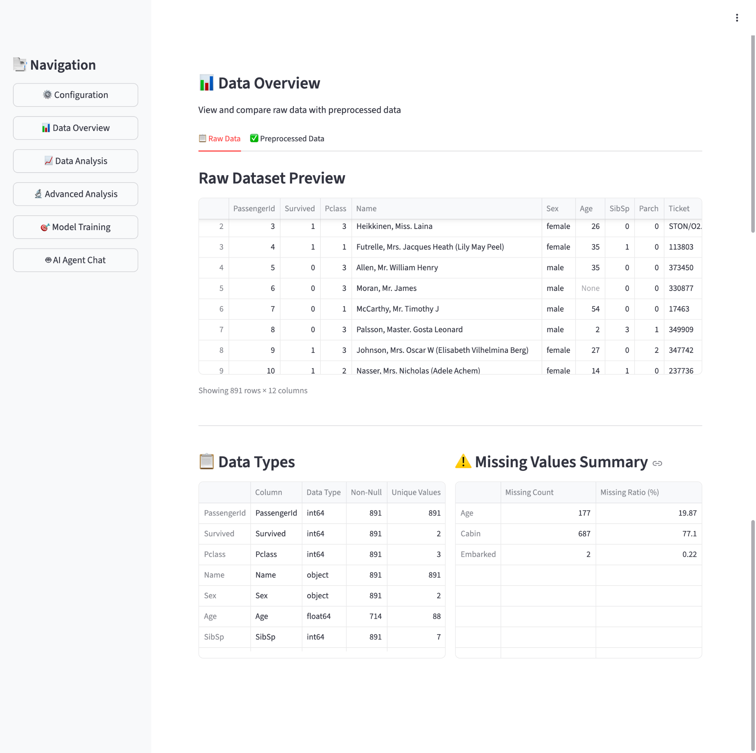
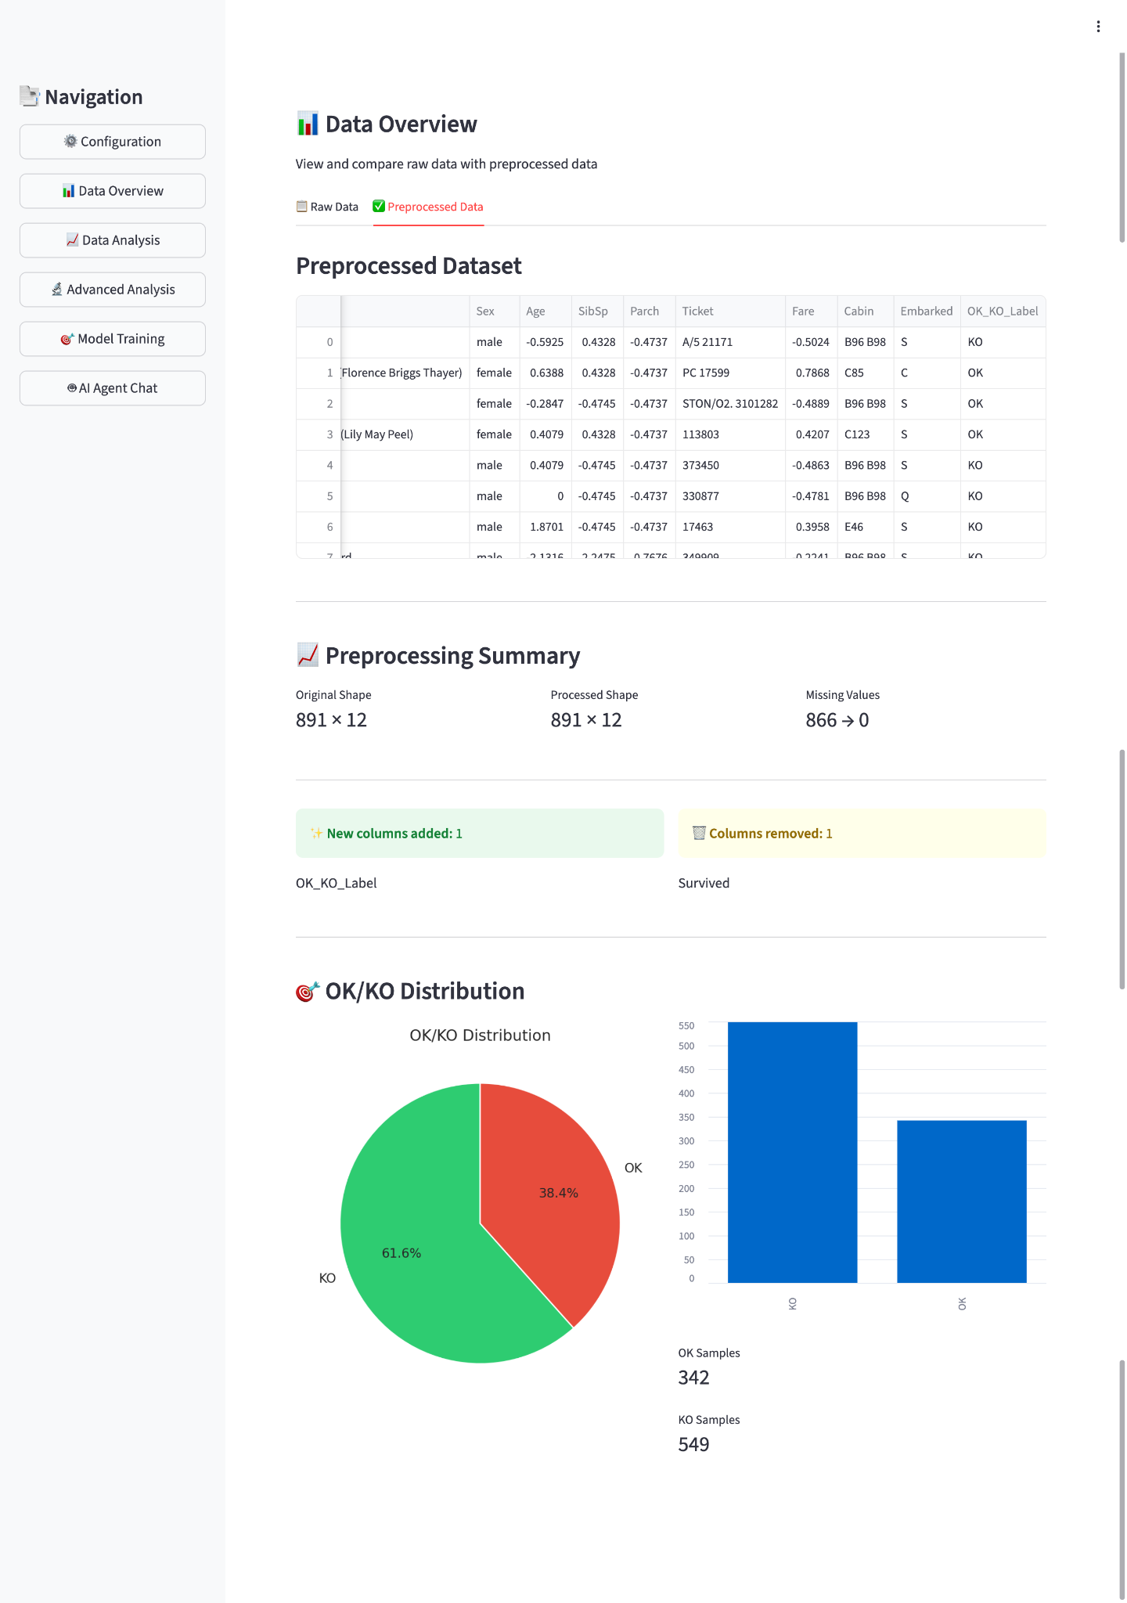
Data Overview
Dataset statistics and initial exploration

Slide 11
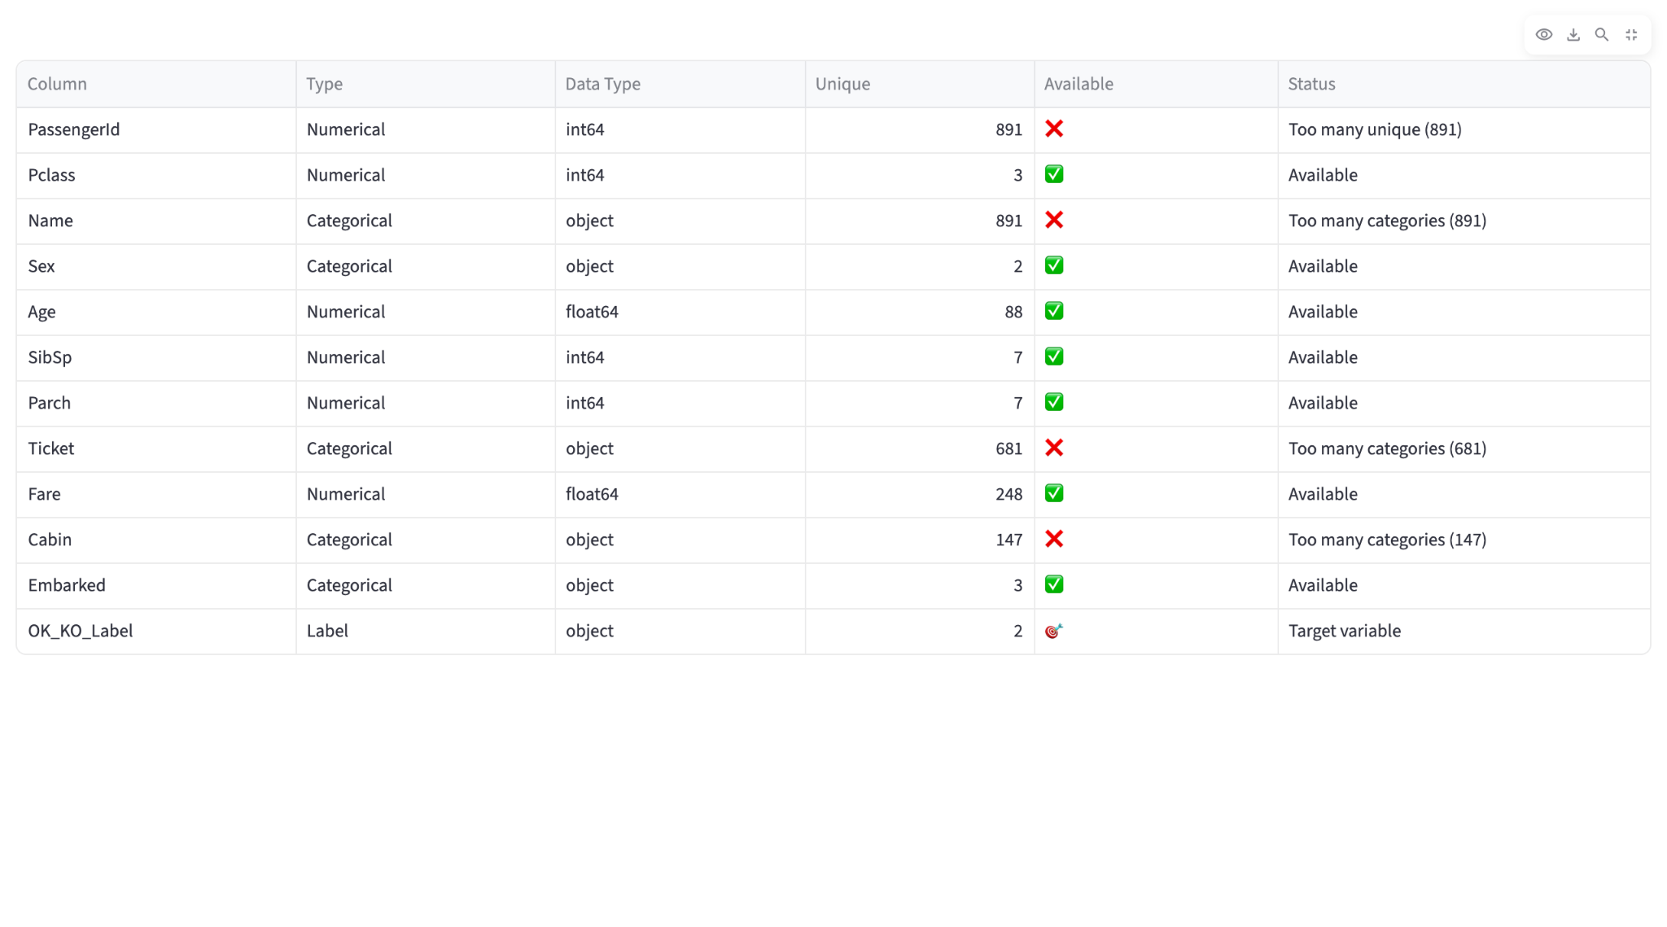
Data Analysis A
Data Analysis

Slide 12
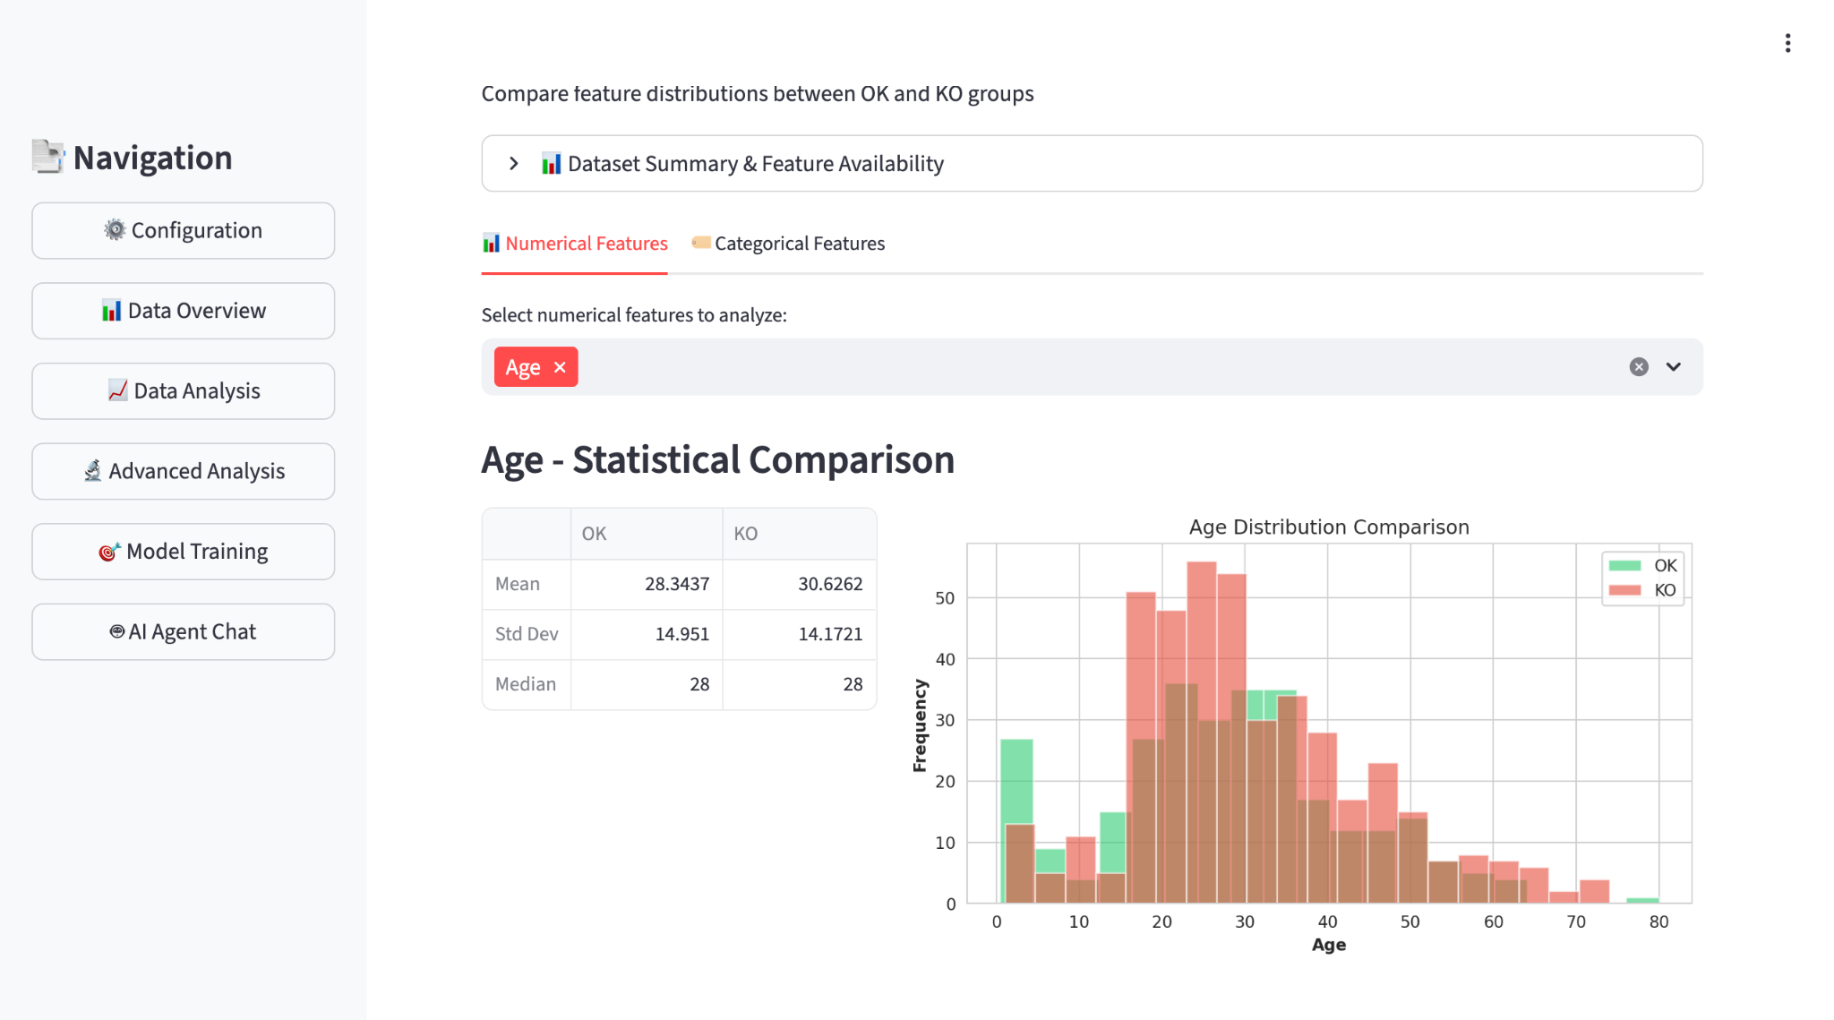
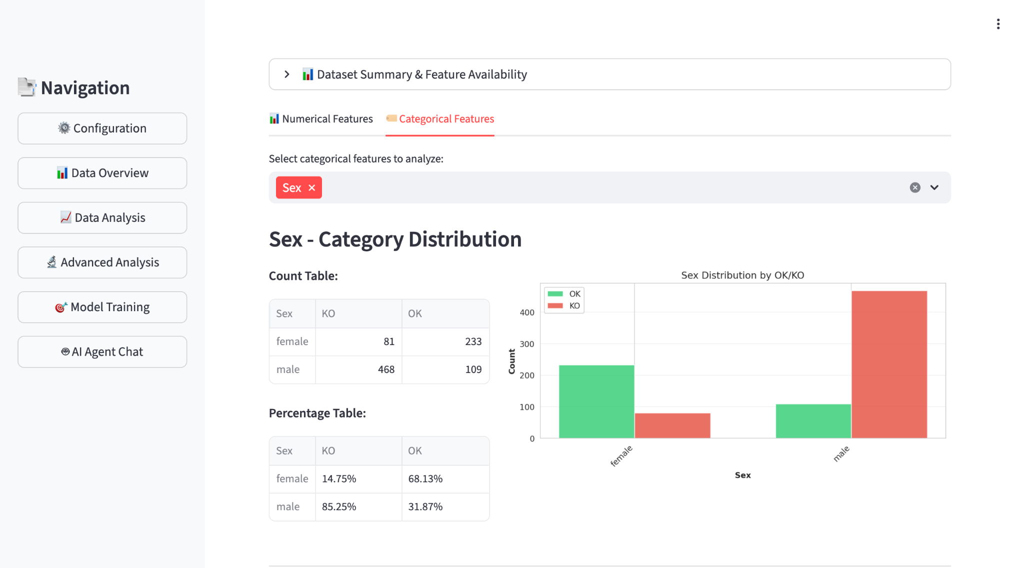
Data Analysis A
Data Analysis

Slide 13
Parallel Validation Approach
Statistical Ranking
ML Ranking
Method
Method
Hypothesis Testing
Ensemble Learning
Metrics
Metrics
p-value + Effect Size
VS
Permutation Importance
Score
Score
-log₁₀(p) × effect
Model-based Importance
Interpretable & Theory-Based
Data-Driven & Predictive

Slide 14
Statistical Ranking
Feature Type | Test Method | Metrics | Purpose
Numeric | T-test | p-value, Cohen's d | Mean difference (parametric)
Numeric | Mann-Whitney U | p-value, Effect size | Rank difference (non-parametric)
Numeric | Kolmogorov-Smirnov | p-value, KS statistic | Distribution difference
Categorical | Chi-square | p-value | Independence test
Categorical | Cramér's V | Effect size (0-1) | Association strength
Composite Ranking Score
Score = -log₁₀(p-value) × effect_size

Slide 15
ML Ranking
AutoGluon Framework
Training Metrics
TabularPredictor
Training Time
~60-120s
Automated ML ensemble training
Ensemble Methods
Best Model
WeightedEnsemble_L2
WeightedEnsemble_L2 as best model
Permutation-Based
Validation Accuracy
0.89
Feature importance via shuffling

Slide 16
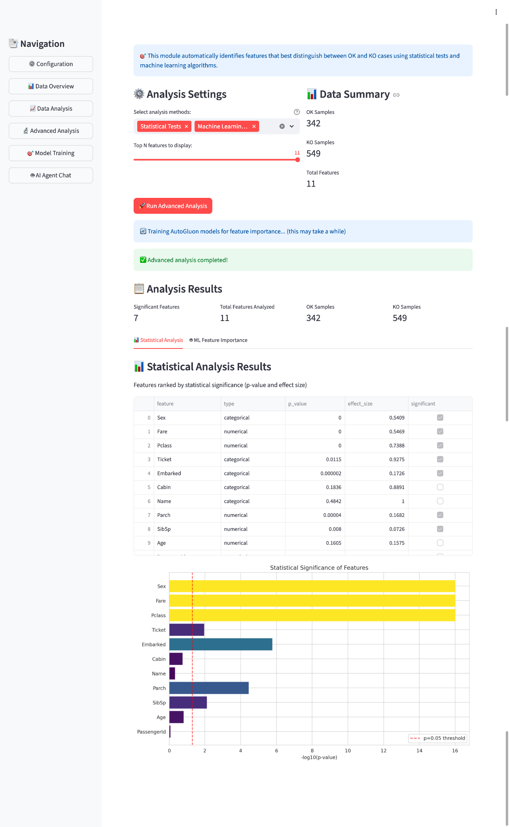
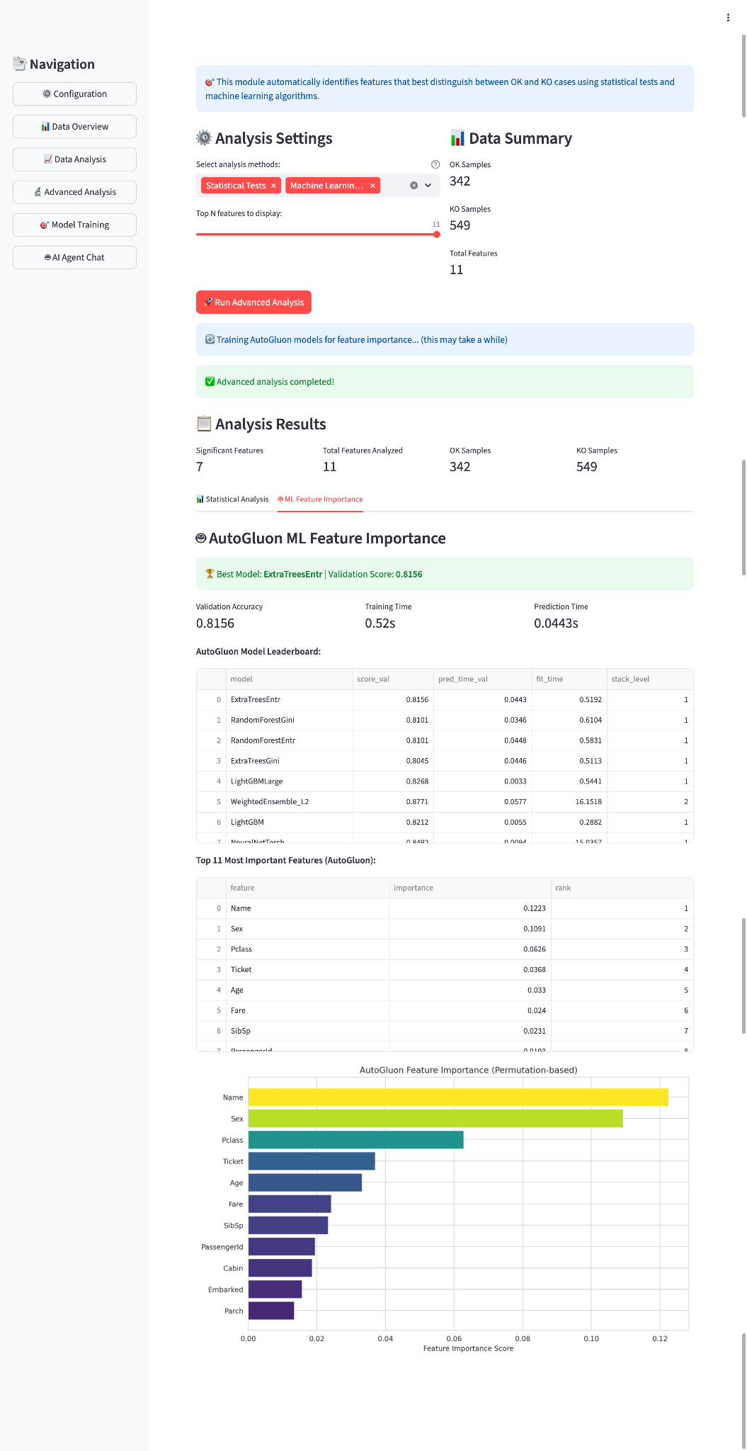
Model performance comparison: Different algorithms × Feature selection methods

Slide 17
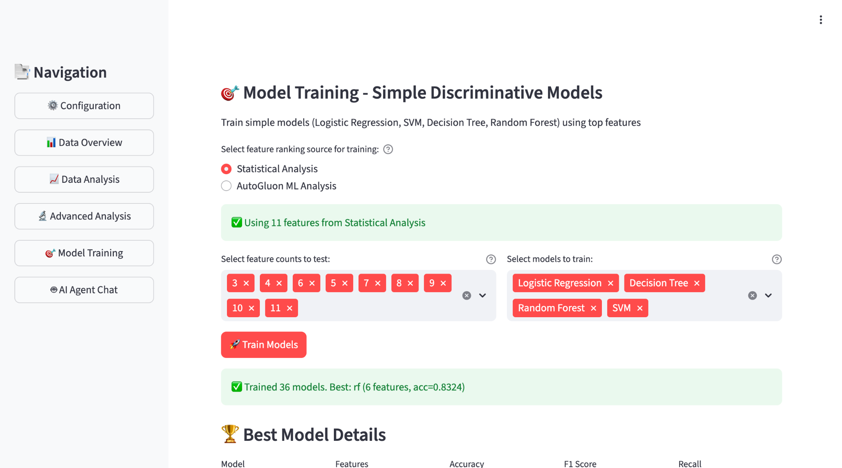
Model Training

Slide 18
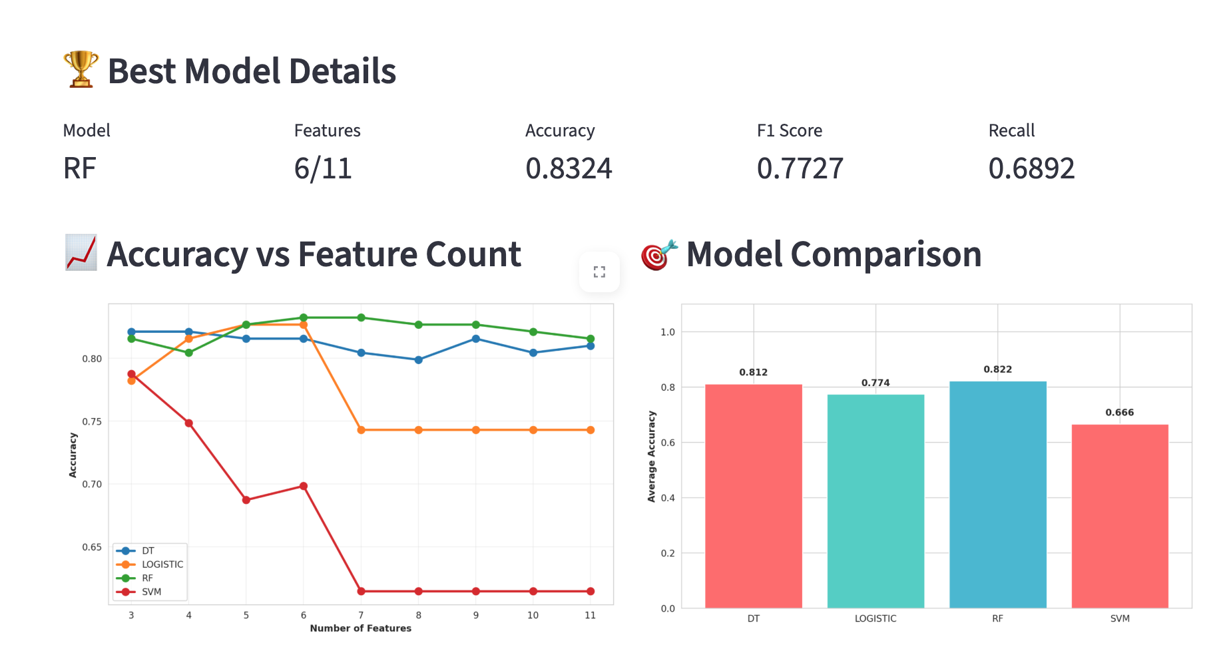
Model Training Results - Statistical
Model performance comparison: Different algorithms × Feature selection methods

Slide 19
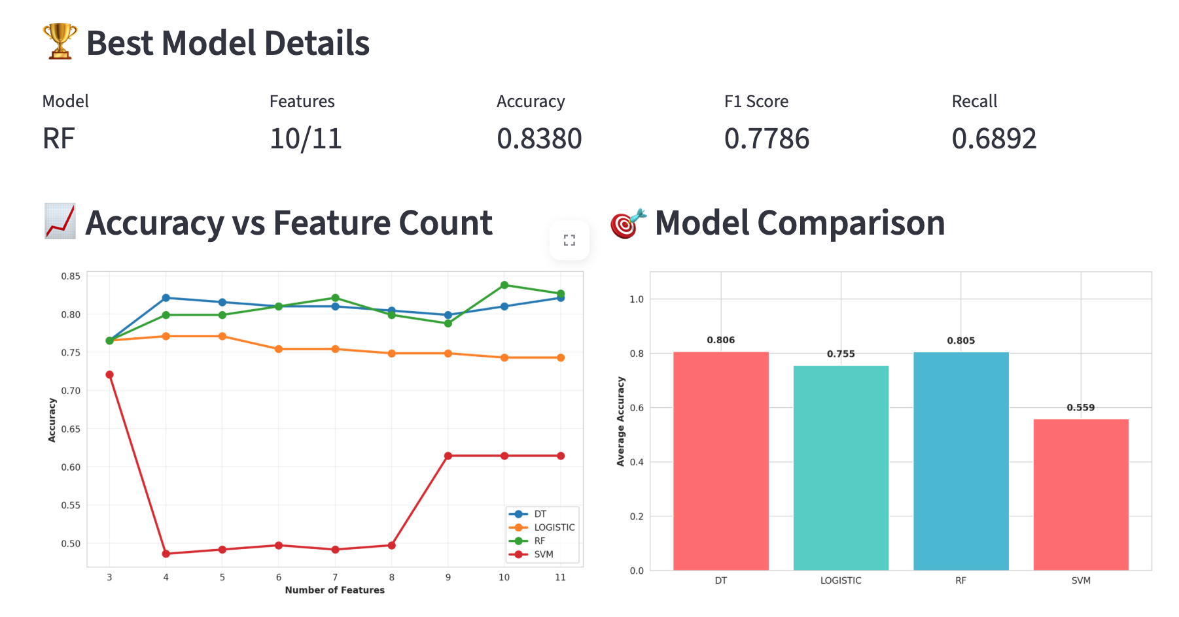
Model Training Results - AutoGluon
Model performance comparison: Different algorithms × Feature selection methods

Slide 20
AI-Powered Chat Interface: Architecture
User Natural Language Query
↓
StatisticalAgent (Intent Parser)
Rule-based + LLM Fallback (LLaMA-3)
↓
Tool Routing
Data Context
• get_feature_importance()
← Session State
• get_statistical_summary()
• processed_df
• plot_distribution()
• analysis_results
• plot_time_series()
• feature_ranking
• plot_frequency_spectrum()
• statistical_summary
↓
Response Generation: Plot + Text Summary

Slide 21
LLM Backend Design
Backend | Deployment | Latency | Use Case
Ollama (LLaMA-3) | Local | 2-5s | Privacy-first deployment
OpenAI GPT-4 | Cloud | 0.5-1s | High accuracy research
Claude / Gemini | Cloud | 0.5-1s | Alternative cloud options
DeepSeek | Cloud | 1-2s | Cost-effective option
ConversationManager
Chat History
Maintains context
Context Window
Manages tokens
Session State
Links to analysis

Slide 22
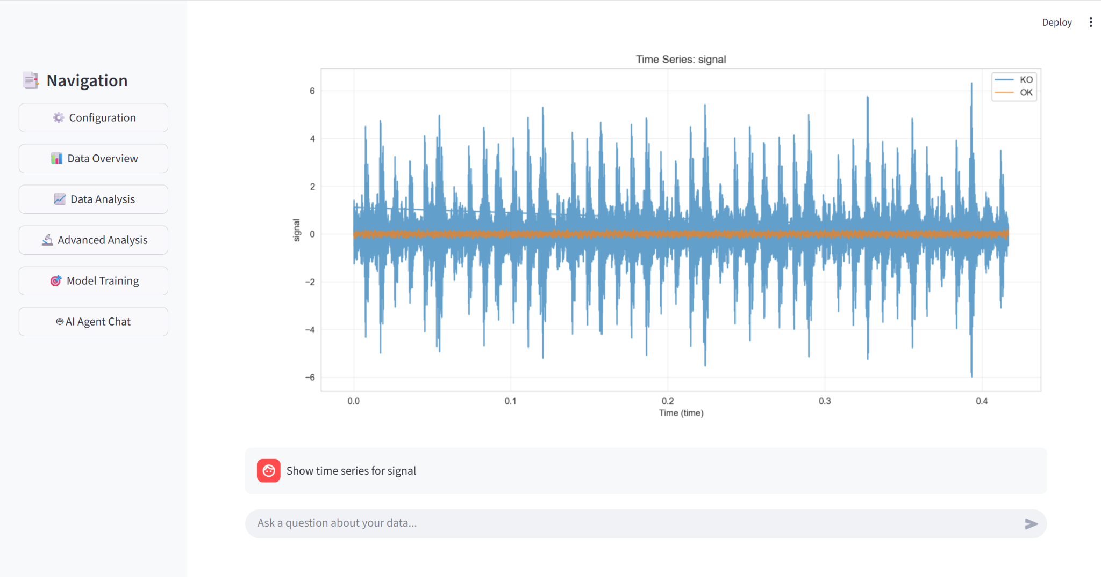
AI Agent Use Case : Time Series Visualization
User query: "Compare distribution of rms between OK and KO"

Slide 23
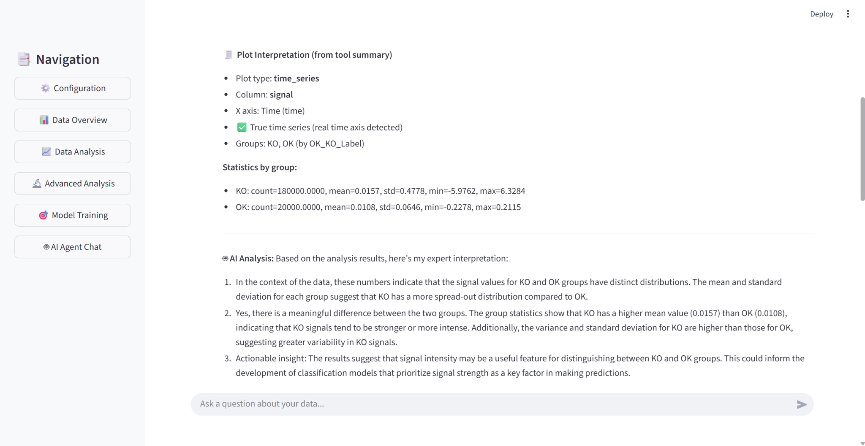
AI Agent Use Case : Time Series Visualization
User query: "Show time series of signal"

Slide 24
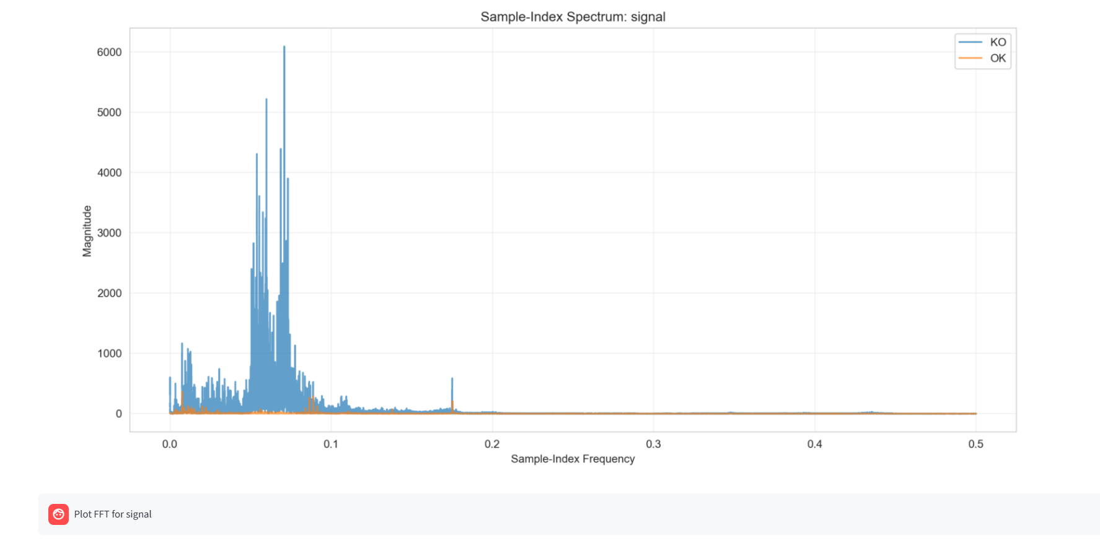
AI Agent Use Case: Frequency Spectrum (FFT)
User query: "Show frequency spectrum" - FFT with peak detection

Slide 25
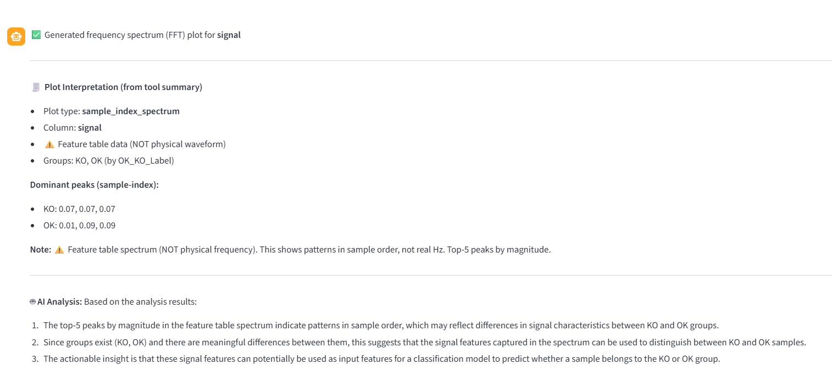
AI Agent Use Case: Frequency Spectrum (FFT)
User query: "What are the statistics for rms?" - Multi-metric view

Slide 26
AI Agent: Technical Highlights
Data Encapsulation
Robust Time Handling
No DataFrame in prompts → prevents hallucination
Auto-detects time columns with graceful fallback
Context-Aware
Flexible Visualization
Receives full analysis results for comprehensive queries
Natural language → plot type selection automatically
Structured Output Pattern
Plot + Summary + AI Interpretation → Deterministic computation (no AI guessing)

Slide 27
System Design Philosophy
1
2
3
Parallel Validation
Shared State
Anti-Hallucination
Statistical + ML methods
run independently
→ user selects best
One analysis
→ multiple consumers
No duplication
Tool-based execution
→ deterministic results
No AI guessing

Slide 28
Limitations & Future Directions
Current Limitations
Future Improvements
Train/eval on same data (no k-fold)
Cross-validation + proper train/test split
Class imbalance not tuned
SMOTE/class weights for balancing
AutoGluon training time ~60-120s
Hyperparameter tuning UI controls
Single-session (no persistence)
Session persistence & report export

Slide 29
Thank You
Key Contributions
✓ Parallel-validation architecture for feature ranking
✓ Multi-backend LLM integration with local deployment
✓ Context-aware AI agent with anti-hallucination design
✓ Interactive visualization toolkit for exploratory analysis
Lei GAO (s327756) • Lan DENG (s338219)

